Slide 1
Cyber Threat Intelligence Sharing Scheme Based on Federated Learning for Network Intrusion Detection and Implementation of Homomorphic encryption for Privacy-preserving

Slide 2
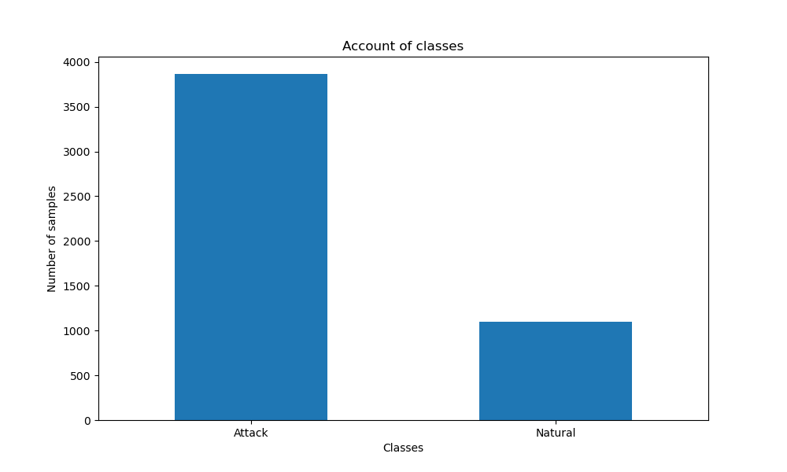
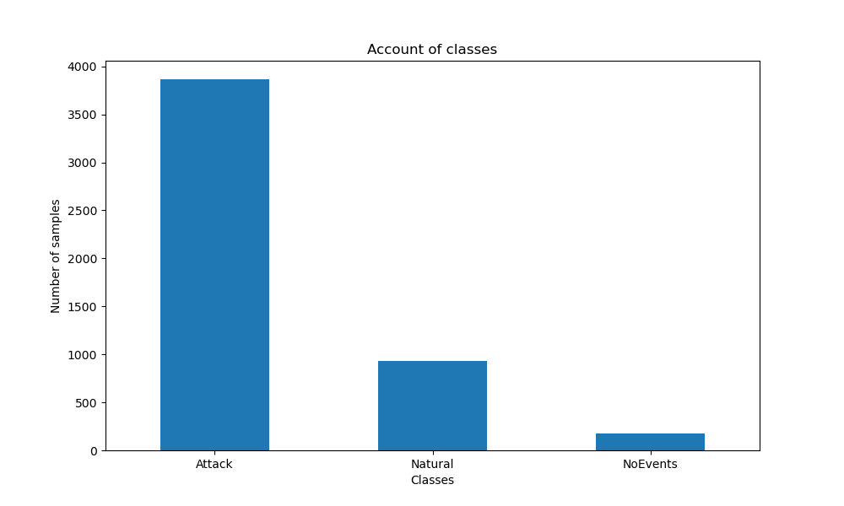
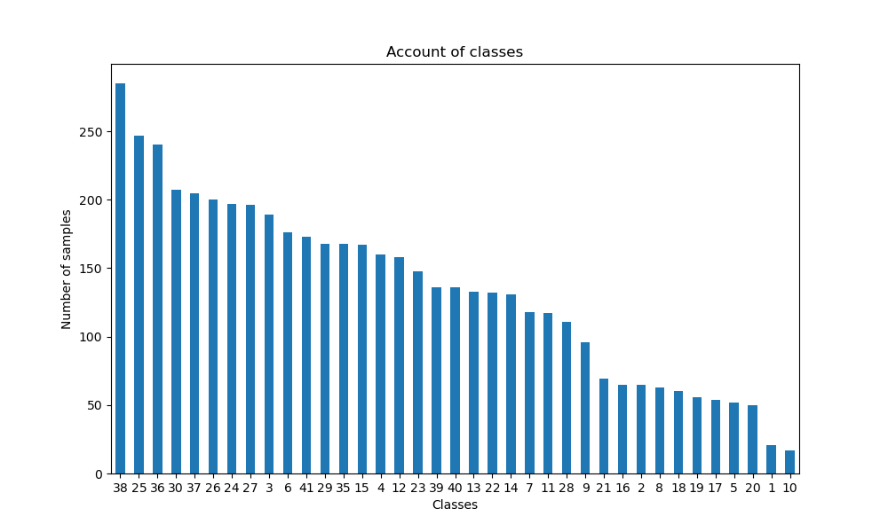
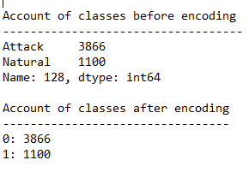
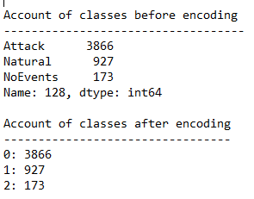
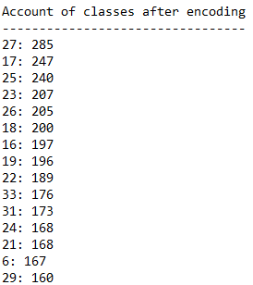


BINARY CLASSES
TRIPLE CLASSES
MULTI CLASSES

Slide 3
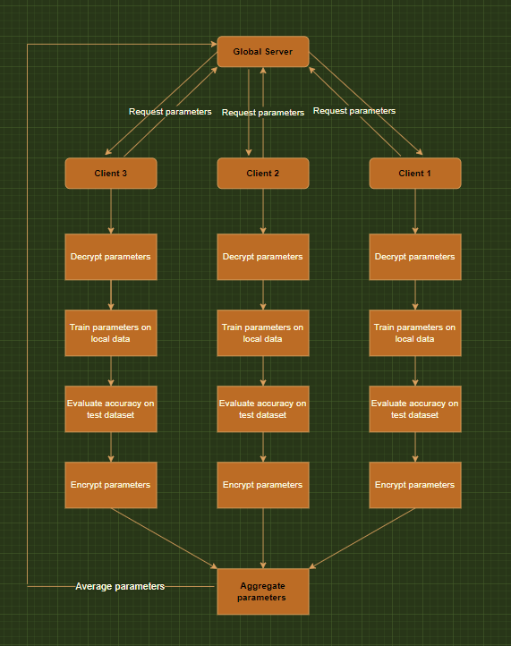
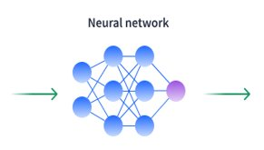
COMMAND LINE ARGUMENTS TO START THE TRAINING PROCESS
DATASET FEATURES AS INPUT
PREDICT TARGET CLASSES AS OUTPUT SUCH AS '0' OR '1'

Slide 4



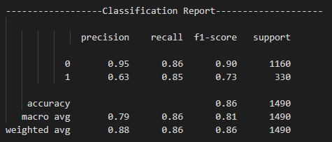

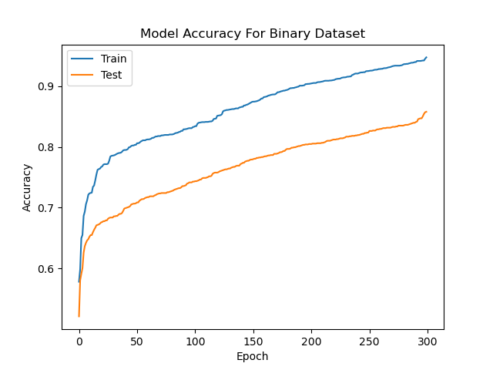
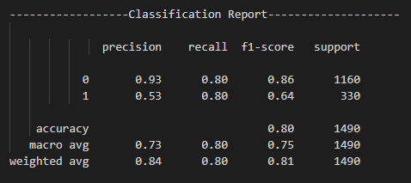
VALIDATING BINARY DATASET RESULTS

Slide 5



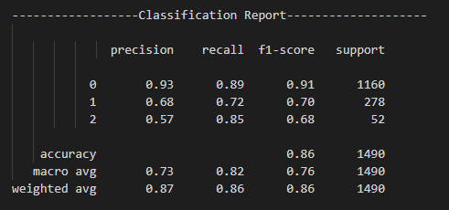

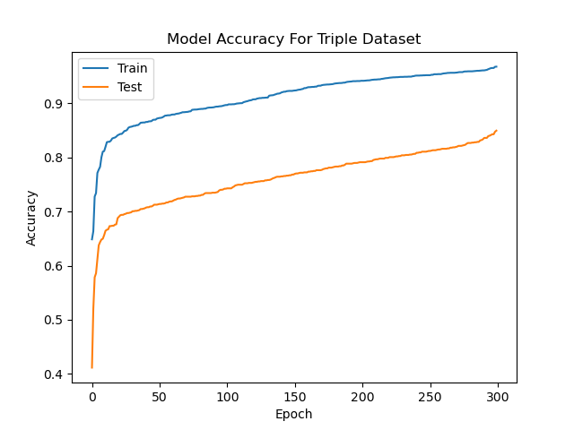
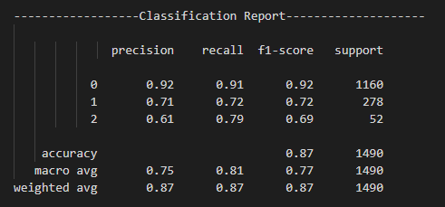
VALIDATING TRIPLE DATASET RESULTS

Slide 6
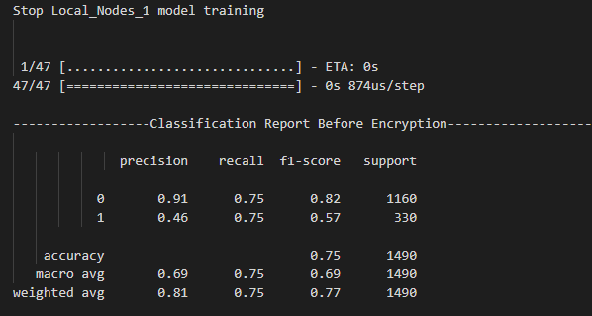
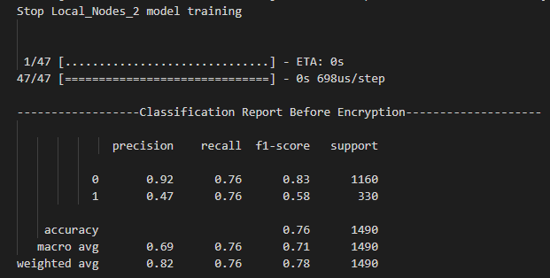
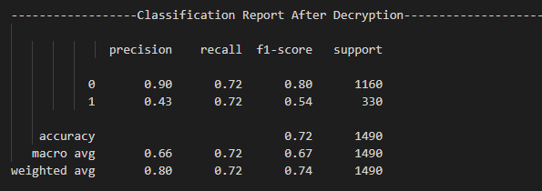
VALIDATING HOMO-MORPHIC ENCRYPTION

